Slide 1

Google Android Overview and Architecture

Slide 2
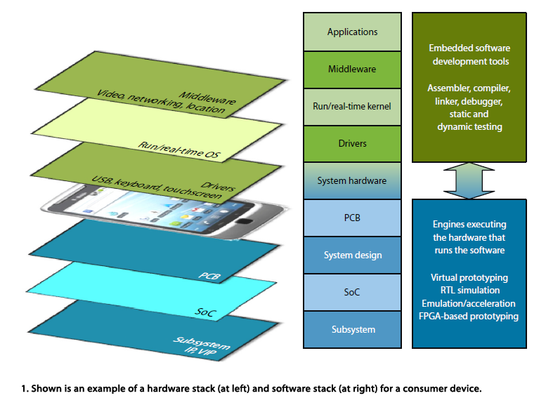
What is Google Android?
Google Android, hereafter referred to just as Android, is a software stack for mobile devices that allows software developers to write programs to run and Android-powered devices.

Slide 3
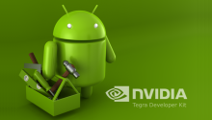
Development Suite
The Android development suite includes an operating system, middleware and some key applications.
The Android software development kit (SDK) provides the tools and functionality necessary to begin developing applications on the Android platform using the Java programming language.

Slide 4
Anyone currently familiar with the Java programming language should readily grasp many of the concepts used in Android development, however those who are new to Java but have previous object oriented programming experience should be able to quickly appreciate the concepts that will be used.

Slide 5
Why choose Android ?
Android is open source, and as such all aspects of the system environment
Android SDK and tools are completely free to download
Android development is done in Java, one of the most widely used programming language around today
Android development is quick and provides rapid prototyping of applications. The rich Android feature set allow impressive looking applications to developed much quicker than on comparative mobile development environments.

Slide 6
Key features of Android SDKs
Application framework: allows reuse and replacement of components.
Virtual machine: optimized for mobile devices allowing applications to run quicker .
Integrated browser based on the open source WebKit technologies/
Optimized graphics: providing both a set of custom two dimensional libraries, and three-dimensional libraries based on the industry standard OpenGL ES 1.0 .
SQLite: SQL database functionality supported to make structured data storage easier.
Media support: providing audio and video support for many industry standard file formats including MPEG4, MP3, JPG and GIF!
GSM Telephony : Providing support for making phone calls and text messaging
Data Communications: Bluetooth, EDGE, 3G, and WiFi (hardware dependent)
Rich development environment including a fast device emulator, debugging tools and an integrated plug in for the Eclipse IDE.

Slide 7
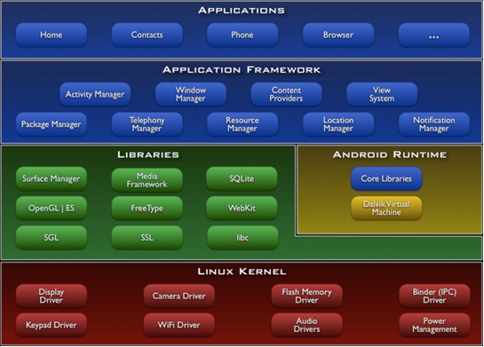
Android Architecture
Notes:
As we have already mentioned Android is a stack based system, divided into several key layers.

Slide 8
Applications
Android will ship with a set of core applications including an email client, SMS program, calendar, maps, browser, contacts, and others. All applications are written using the Java programming language.

Slide 9
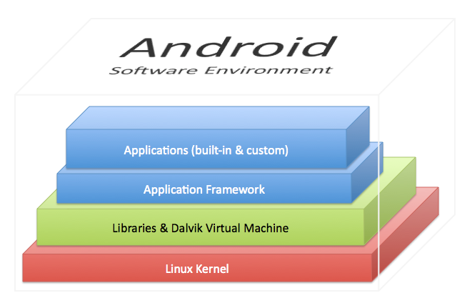
Application Framework
Developers have full access to the same framework APIs used by the core applications.
The application architecture is designed to simplify the reuse of components;
any application can publish its capabilities and any other application may then make use of those capabilities (subject to security constraints enforced by the framework).
This same mechanism allows components to be replaced by the user.

Slide 10
Underlying all applications is a set of services and systems
A rich and extensible set of Views that can be used to build an application, including lists, grids, text boxes, buttons, and even an embeddable web browser
Content Providers that enable applications to access data from other applications (such as Contacts), or to share their own data
A Resource Manager, providing access to non-code resources such as localized strings, graphics, and layout files
A Notification Manager that enables all applications to display custom alerts in the status bar
An Activity Manager that manages the lifecycle of applications and provides a common navigation stack

Slide 11
Typical services and systems
Libraries
Android Runtime
Linux Kernel

Slide 12
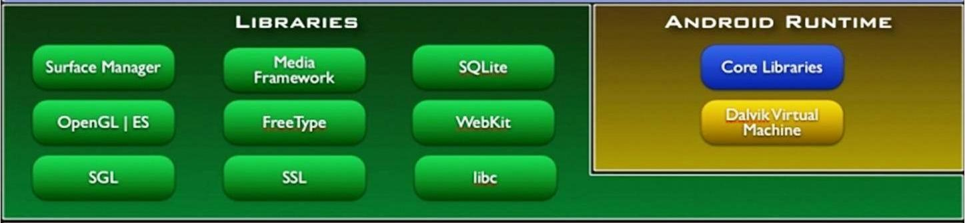
Libraries
Android includes a set of libraries used by various components of the Android system. These capabilities are exposed to developers through the Android application framework.

Slide 13
Some of the core libraries
System C library - a BSD-derived implementation of the standard C system library (libc), tuned for embedded Linux-based devices
Media Libraries - based on PacketVideo's OpenCORE; the libraries support playback and recording of many popular audio and video formats, as well as static image files, including MPEG4, H.264, MP3, AAC, AMR, JPG, and PNG
Surface Manager - manages access to the display subsystem and seamlessly composites 2D and 3D graphic layers from multiple applications
LibWebCore - a modern web browser engine which powers both the Android browser and an embeddable web view
SGL - the underlying 2D graphics engine
3D libraries - an implementation based on OpenGL ES 1.0 APIs; the libraries use either hardware 3D acceleration (where available) or the included, highly optimized 3D software rasteriser.
FreeType - bitmap and vector font rendering
SQLite - a powerful and lightweight relational database engine available to all applications

Slide 14
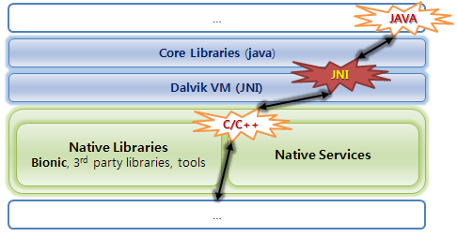
Android Runtime
Every Android application runs in its own process, with its own instance of the Dalvik virtual machine
Dalvik has been written so that a device can run multiple VMs efficiently.
The Dalvik VM executes files in the Dalvik Executable (.dex) format which is optimized for minimal memory footprint. T
The VM is register-based, and runs classes compiled by a Java language compiler that have been transformed into the .dex format by the included "dx" tool.
The Dalvik VM relies on the Linux kernel for underlying functionality such as threading and low-level memory management.

Slide 15
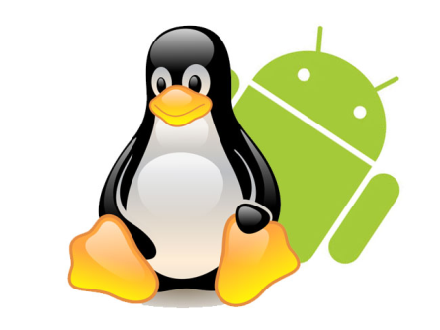
Linux Kernel
The Android kernel is currently based on Linux v2.6 and as relies on this for core system services such as security, memory management, process management, network stack, and driver model. The kernel also acts as an abstraction layer between the hardware and the rest of the software stack.

